Slide 1
4th Year Project
Programme Name: BSc. Honours in Data Science
Specialisation: BSHDS4
Academic Year: 2022/2023
Student Name: Benjamin Kelly
Project Title: An analysis of the causes and prevention of diabetes

Slide 2
Project Overview
What is the project? The project aims to identify the most suitable model or classifier that could be used to predict the likelihood of someone becoming diabetic based on various data points. A number of classification models were implemented on health, diabetes and lifestyle datasets and a detailed analysis of the results was carried out and conclusions were made.
What problem does it address? Diabetes is a medical condition that is characterised by high blood sugar levels. One in ten people around the world are living with diabetes which is one of the top ten leading causes of deaths globally. Healthcare service resources are increasingly stretched to meet the growing demand for services associated with this disease.
Who is it for? My project help examine how diabetes can be controlled by analysing and understanding risk factors associated with the disease. This data could be useful for policy makers and health providers in better understanding the links between diabetes and it’s causes to shape healthcare services in this area.
How is it different? The project focuses on the performance of a different combination of models and brings together different datasets to those used by other published research in the area of diabetes.

Slide 3

Project Aims
The project aims included:
Exploring appropriate classification models to determine what model is best for predicting the output of someone being diabetic.
Exploring what are the factors that would most influence this outcome.
To use suitable statistical analysis to help us understand the importance of various lifestyle and other related data features and their correlations.
Research question for this project was:
“Given relevant data and the application of classifiers on that data, what is the likelihood of someone being diagnosed as a diabetic?”.

Slide 4

Technologies Used
Coding platforms used:
PowerBI was selected because I had prior experience using it in my internship. It was used initially to carry out some visualisation analysis of my chosen datasets. This helped me understand specific statistical details such as correlations among features and identify patterns amongst features.
Jupyter notebook was selected for Python programming and the implementation of Neural Network models.
RStudio was selected as I used this tool a lot during my internship. It was used to:
Carry out statistical analysis of the datasets during the earlier parts of the project at the data exploration stage.
Used to implement four different types of classification models.
Neural Network models were not carried out in R as python had more resources available for this task.
There are other web based tools such as Google Collab which were also explored

Slide 5
Datasets used
I sourced the following datasets from Kaggle.
The ’10 Years Diabetes Dataset’ representing 10 Years (1999-2008) of clinical care sourced at 130 US hospitals and integrated delivery networks. It had over fifty features representing patient and hospital outcomes.
The “Diabetes Health Indicators” dataset containing data about risk factors for diabetes also over a 10 year period including information about whether someone is diabetic.
Project methodology: The project was implemented using the CRISP-DM methodology as I felt this was most suitable based on my experience from the internship and other projects.

Slide 6
Data analysis techniques
Exploratory Analysis included:
PowerBI visualisation
Histogram Analysis
Correlation analysis
Statistical analysis
Mean and standard deviation analysis
Frequency analysis
Pearson Chi-Squared test
Student T Tests
Non-parametric tests
Cohens Kappa Score
Imputation
Mice

Slide 7
Data preparation Techniques Used
Imputation methods
Replacing values
Creating data subsets
Merging data frames
One-Hot encoding and Encoding values.

Slide 8
Data models used
Models implemented
Random Forest
Decision trees
Naïve Bayes
Neural Networks
Dataset approach
The ’10 Years Diabetes Dataset’
Regular Splitting
“Diabetes Health Indicators dataset’ had three different subsets created
Regular splitting
Down Sample
Smote

Slide 9
Data modelling activities
Model implementation activities for Random Forest/Decision trees/Naïve Bayes:
Splitting the data
Train and test
Checking proportions
Factoring variables
Fitting data to the model
Collecting predictions
Computing the confusion matrix
Carry out predictions
Plot the models
Neural Networks
4 network models
Hypermodel
Tools used
tensorflow
tensorflow.keras.layers
keras_tuner

Slide 10
Results of modelling
Assessed models in terms of accuracy and prediction of the project objective (i.e. to predict the incidence of diabetes)
The three top performing models for this project objective were:
Neural Networks Smote Hyper Model,
Random Forest Down sampled model
Down sampled Decision Tree model.
Above were best on model predictions, train and test predictions and overall performance.
Neural Network Smote model achieved an accuracy > 90%.
Other model accuracy was between 70%-75%.
AI is superior to normal machine learning models (such as Decision Trees) for the project objective

Slide 11
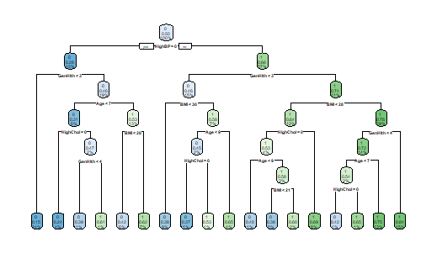
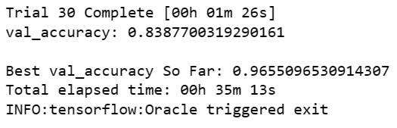
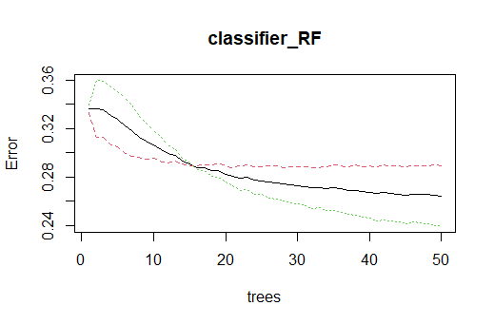
Results (Sample)
Decision Tree Model Architecture Downsampled Model
Highlights important features at each split
Neural Network Smote Model
Best accuracy on all trials .96
Red = Non -Diabetic
Green = Diabetic
Random Forest model downsampled
Forest has 50 trees in the model
Error rate changes with the number of trees
Non diabetic rate flattens out
Diabetic error rate reducing with the number of trees

Slide 12

Testing & Evaluation
The testing stage involved the following:
Running the models
Implementing adjustments based on results
Changing up hyperparameters in the functions
Changing how data was presented etc.
Re-running the models
For Neural networks
Process as above
Tuning the hyperparameters such as batch size and epoch size
Noting output to check how fast the models were running.

Slide 13
Demonstration
Coding overview
Run Scripts

Slide 14
Script walkthrough
Walk through scripts used to generate the results

Slide 15
Questions and Answers (i)
Question: What were the most difficult aspects of the project?
Answer:
Understanding the logic behind the models and interpreting what the results were saying about the models took some time to figure out.
Areas that were challenging and time consuming were:
The confusion matrix, the charts, predictions on train and test data
Labelling rows in the testing data frame (Naïve Bayes only).

Slide 16
Questions and Answers (ii)
Question: What was the most innovative aspect of the project.
Answer:
Implementing the models in R. The use of over sampling, under sampling techniques such as Smote are down sampling involved a lot of scripting and analysis work which is different to the regular splitting techniques.
Implementation of the Neural network model in Python made great use of the Python resources available. This area was most interesting as I could experiment a lot more with the models and observe the output of the model while in execution mode. In found it more interesting when observing values and parameters.

Slide 17
Questions and Answers (iii)
Question: Have my project Aims and Objectives changed and what impact has this had on the project?
Answer:
The original project proposal intended to look at data relating to Type 1 and Type 2 data internationally and making comparisons from the data between countries.
In the final implementation, the project focused more the best models to analyse the link between diabetes causes and lifestyle data.
The final project implementation focused on diabetic data from the US (not international) as this was the best available data for the project objective.
Further analysis of the factors influencing Type 2 diabetes would have been beneficial if extra time was permitted.

Slide 18
Questions and Answers (iv)
Question: Describe the approach to testing
Answer:
The testing stage involved the following:
Running the models
Implementing adjustments based on results
Changing up hyperparameters in the functions
Changing how data was presented etc.
Re-running the models
For Neural networks
Process as above
Tuning the hyperparameters such as batch size and epoch size
Noting output to check how fast the models were running.

Slide 19
Questions and Answers (v)
Question: What decisions would I change if doing project again?
Answer:
Analysis Techniques changes:
I would have carried out more value distributions and chi-square independent tests prior to the machine learning stage. This would help identify whether the features were suitable for certain algorithms like Naive Bayes.
I would have tried a different approach incorporating multiple target classes within a feature (e.g. analysis of pre-diabetes data)
There were two redundant features which impacted the performance of the Smote models. Deleting the features in the Diabetes Health indicators dataset would have been better.
Data analysed
Data on pre-diabetes would have been worth incorporating into the project

Slide 20
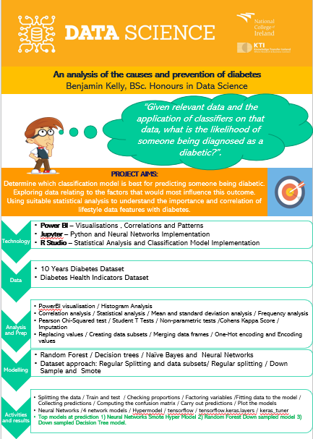
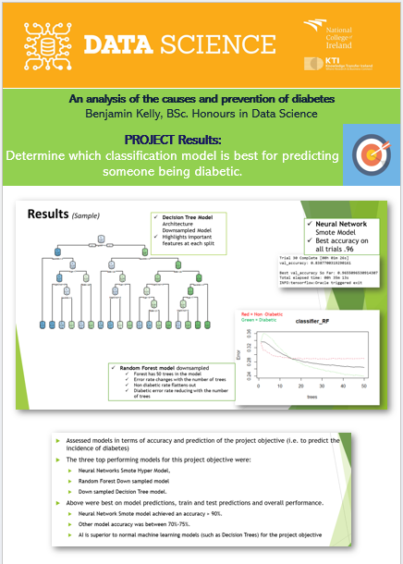
Poster

